Slide 1

Team SEWZ: Project report
Shouyu Ling, Eric Chang, Wei Shao, Zorry Belchev

Slide 2
Experiment overview: Training Phase

Slide 3
Predict performance on Block 3
Regression model based on invisible trials
Block 3 Performance
Block 2 Performance
Environment Type
Rural
Urban
Reward Type
Food
Water
Money

Slide 4
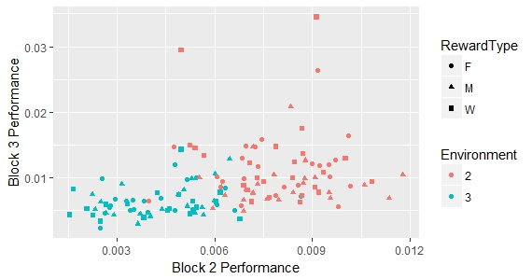
Predict performance on Block 3
Regression model : Results
REML criterion at convergence: -1079.9
Variable | F | p
Block2Performance | 0.69 | .41
Environment | 13.87 | .0003
RewardType | 2.12 | .12

Slide 5
Predict performance on Block 3
Follow-up analysis separated by environment
Block 3 Performance
Block 2 Performance
Environment Type
Rural
Urban
Reward Type
Food
Water
Money

